Slide 1
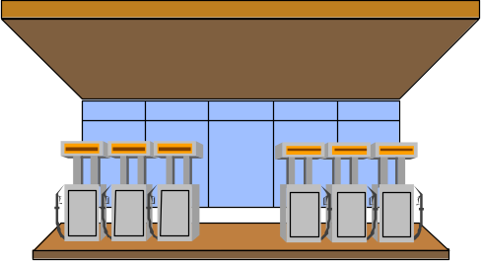

Pipelined Processor Design
Hazards
  Data
  Resource/Structural
  Control
GAS STATION

Slide 2
Hazards
Recall Data Hazards are just one type of hazard that can occur in a machine.
Hazards (Dependency)
  Data hazards
    Instruction depends on result of prior computation which is not ready yet
  Structural hazards
    HW cannot support a combination of instructions
  Control hazards
    pipelining of branches and other instructions which change the PC

Slide 3
Structural Hazard Example 1
W/out adder, both the address computation and the arithmetic computation would require access to the ALU in the same cycle
beq r1,r2, offset ; if r1 == r2, then PC <-- PC + offset
M
U
X
Current PC
IF/ID
ID/EX
EX/MEM
MEM/WB
4
Adder
<< 2
ADDER
PC
Data Memory
(RAM)
Register File
Read Reg 1
Read Reg 2
Write Reg
Write Data
Zero
Read
Data 1
Read
Data 2
M
U
X
M
U
X
Instruction
Memory (RAM)
ALU
Read
data
Sign
extend
16
32

Slide 4
Control Hazards - Branches
Example code
Address Instruction
36 NOP
40 ADD R30,R30,R30
44 BEQ R1, R3, 24 <- this branch to address 72
48 AND R12, R2, R5
52 OR R13, R6, R2
56 ADD R14, R2, R2
60 ...
64 ...
68 ...
72 LW R4, 50(R7)
76 ...
Flow of instructions if branch is taken: 36, 40, 44, 72, ...
Flow of instructions if branch is not taken: 36, 40, 44, 48, ...

Slide 5
Always Stalling hurts the No-branch case
Two possible improvement:
1. Branch prediction
assume one way and pull back if incorrect
2. Reduce the no. of stalls
by calculating branch condition as early as possible
Flow of instructions if branch is not taken: 36, 40, 44, 48, ...
44 BEQ R1, R3, 24
stall
stall
stall
48 AND R12, R2, R5
IM
REG
ALU
DM
Reg
IM
bubble
bubble
bubble
bubble
IM
bubble
bubble
bubble
bubble
IM
bubble
bubble
bubble
bubble
IM
REG
ALU
DM
Reg

Slide 6
Move the Branch Computation Forward
M
U
X
Current PC
IF/ID
ID/EX
EX/MEM
MEM/WB
4
Adder
<< 2
ADDER
PC
Data Memory
(RAM)
Register File
Read Reg 1
Read Reg 2
Write Reg
Write Data
Zero
Read
Data 1
Read
Data 2
M
U
X
M
U
X
Instruction
Memory (RAM)
ALU
Read
data
Sign
extend
16
32

Slide 7
Branch with New Datapath
Reducing penalty 1 cycle
IM
ALU
Reg
44 BEQ R1, R3, 24
48 AND R12, R2, R5
52 OR R13, R6, R2
72 LW R4, 50(R7)
REG
DM
IM
REG
ALU
DM
Reg
IM
REG
ALU
DM
Reg
IM
REG
ALU
DM
Reg

Slide 8
Move the Branch Computation Further Forward
M
U
X
Compare Controls MUX Selext
Current PC
IF/ID
ADDER
ID/EX
EX/MEM
MEM/WB
4
Adder
Compare
<< 2
ADDER
PC
Data Memory
(RAM)
Register File
Read Reg 1
Read Reg 2
Write Reg
Write Data
Zero
Read
Data 1
Read
Data 2
M
U
X
M
U
X
Instruction
Memory (RAM)
ALU
Read
data
Sign
extend
16
32

Slide 9
Another New and Improved Datapath
IM
ALU
Reg
44 BEQ R1, R3, 24
48 AND R12, R2, R5
72 LW R4, 50(R7)
REG
DM
IM
bubble
IM
REG
ALU
DM
Reg

Slide 10
Branch Delay Slot
Assuming always one next to the branch is something unrelated
IM
ALU
Reg
44 BEQ R1, R3, 24
48 AND R12, R2, R5
72 LW R4, 50(R7)
REG
DM
IM
REG
ALU
DM
Reg
IM
REG
ALU
DM
Reg

Slide 11
Rewriting the Code for a Branch Delay Slot
Without Branch Delay Slot With Branch Delay Slot
Address Instruction Address Instruction
36 NOP 36 NOP
40 ADD R30,R30,R30 40 BEQ R1, R3, 28
44 BEQ R1, R3, 24 44 ADD R30, R30, R30
48 AND R12, R2, R5 48 AND R12, R2, R5
52 OR R13, R6, R2 52 OR R13, R6, R2
56 ADD R14, R2, R2 56 ADD R14, R2, R2
60 ... 60 ...
64 ... 64 ...
68 ... 68 ...
72 LW R4, 50(R7) 72 LW R4, 50(R7)
76 ... 76 ...
Flow of instructions if branch is taken: 36, 40, 44, 72, ...
Flow of instructions if branch is not taken: 36, 40, 44, 48, ...

Slide 12
Performance of Pipelined Systems
Stalls due to data and branch hazards make performance less than one instruction per cycle
Compiler is critical in determining overall performance
  Compiler generates code that avoids stalls
Example
  lw R15, 0x00(R2)
  add R14, R15, R15
  lw R16, 0x04(R2)
  Might become:
  lw R15, 0x00(R2)
  lw R16, 0x04(R2)
  add R14, R15, R15

Slide 13
Pipeline Speedup and Throughput
Assume instruction execution takes n stages
  s₁, s₂, ... s_{n} with each stage per cycle t_{c}
Without pipelining (assuming still n stages)
  Throughput = 1/(n*t_{c} ) (for to n stage)
  Latency = 1/throughput = n*t_{c}
With pipelining
  Throughput n/ n*t_{c} = 1/ t_{c}
  Latency = n/throughput = t_{c}
  Speedup = n*t_{c} / t_{c} <= n

Slide 14
Exceptions and Interrupts
Exceptions are exceptional events that disrupt the normal flow of a program
Terminology varies between different machines
Examples of Interrupts
  User hitting the keyboard
  Disk drive asking for attention
  Arrival of a network packet
Examples of Exceptions
  Memory error
  Overflow
  Page fault

Slide 15
Handling Exceptions and Interrupts
When do we jump to an exception
Upon detection, invoke the OS to service the event
  Right when it occurs?
  What about in the middle of executing a multi-cycle instruction
    Difficult to abort the middle of an instruction
  Processor checks for event at the end of every instruction
  Processor provides EPC and Cause registers to help OS determine cause of event
    EPC - Exception Program Counter
      Holds PC that the OS should jump to when resuming execution
    Cause Register
      Holds bit-encoded cause of the exception

Slide 16
Exception Flow
When an exception (or interrupt) occurs, control is transferred to the OS
User Process
Operating System
Event
exception
Exception processing
by exception handler
Exception return (optional)
Flush out instructions fetched after exception by making them as nops

Slide 17
Flushing Pipe for exception
Assume overflow at ADD – EX stage
44 SUB R1, R3, 24
48 AND R12, R2, R5
52 OR R13, R6, R2
56 ADD R14, R2, R2
5A SLT R16, R6, R7
5D LW R15, 50(R7)
IF ID EX M WB
IF ID EX M WB
IF ID EX M WB
IF ID EX M WB
IF ID EX M
IF ID EX
Detect overflow
Interrupt:
Flush pipe;
jmp to interrupt handler
Which PC, 5A or 6x to use?
precise interrupt

Slide 18
Out-of-Order
Memory Fault
ALU fault
44 BEQ R1, R3, 24
48 AND R12, R2, R5
(delay slot)
52 OR R13, R6, R2
56 ADD R14, R2, R2
IF ID
IF ID EX M WB
IF ID EX M
IF ID EX

Slide 19
Dynamic Branch Prediction
With single-issue pipe, dynamic branch prediction may be a novel scheme,
but an essential feature for multiple-issue pipes
Dynamic Prediction based on branch history
Just looking at the history of the branch for prediction → prediction in isolation
Looking at the history of other branches in addition to the branch for prediction
→ correlating prediction

Slide 20
Bi-modal (saturating counter) predictor
Bi-modal predictor:
  Only Two consecutive mis-predictions cause prediction change.
  2-bit “saturating” counter: state variable is a number
N
T(+1)
0N
1N
State variable is
a counter
N(-1)
T (+1)
N (-1)
N(-1)
3 T
2 T
T(+1)
T

Slide 21
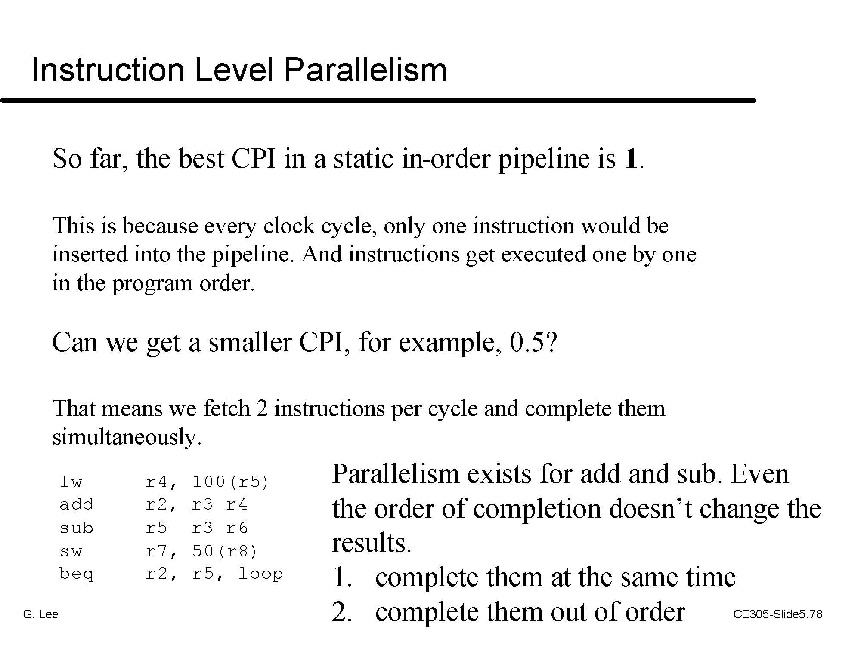
More on Processor Architecture
CNCE433 – Computer Organization (?)
CNCE4xx – Processor Architecture
CRE652 – Advanced Processor Architecture

Slide 22
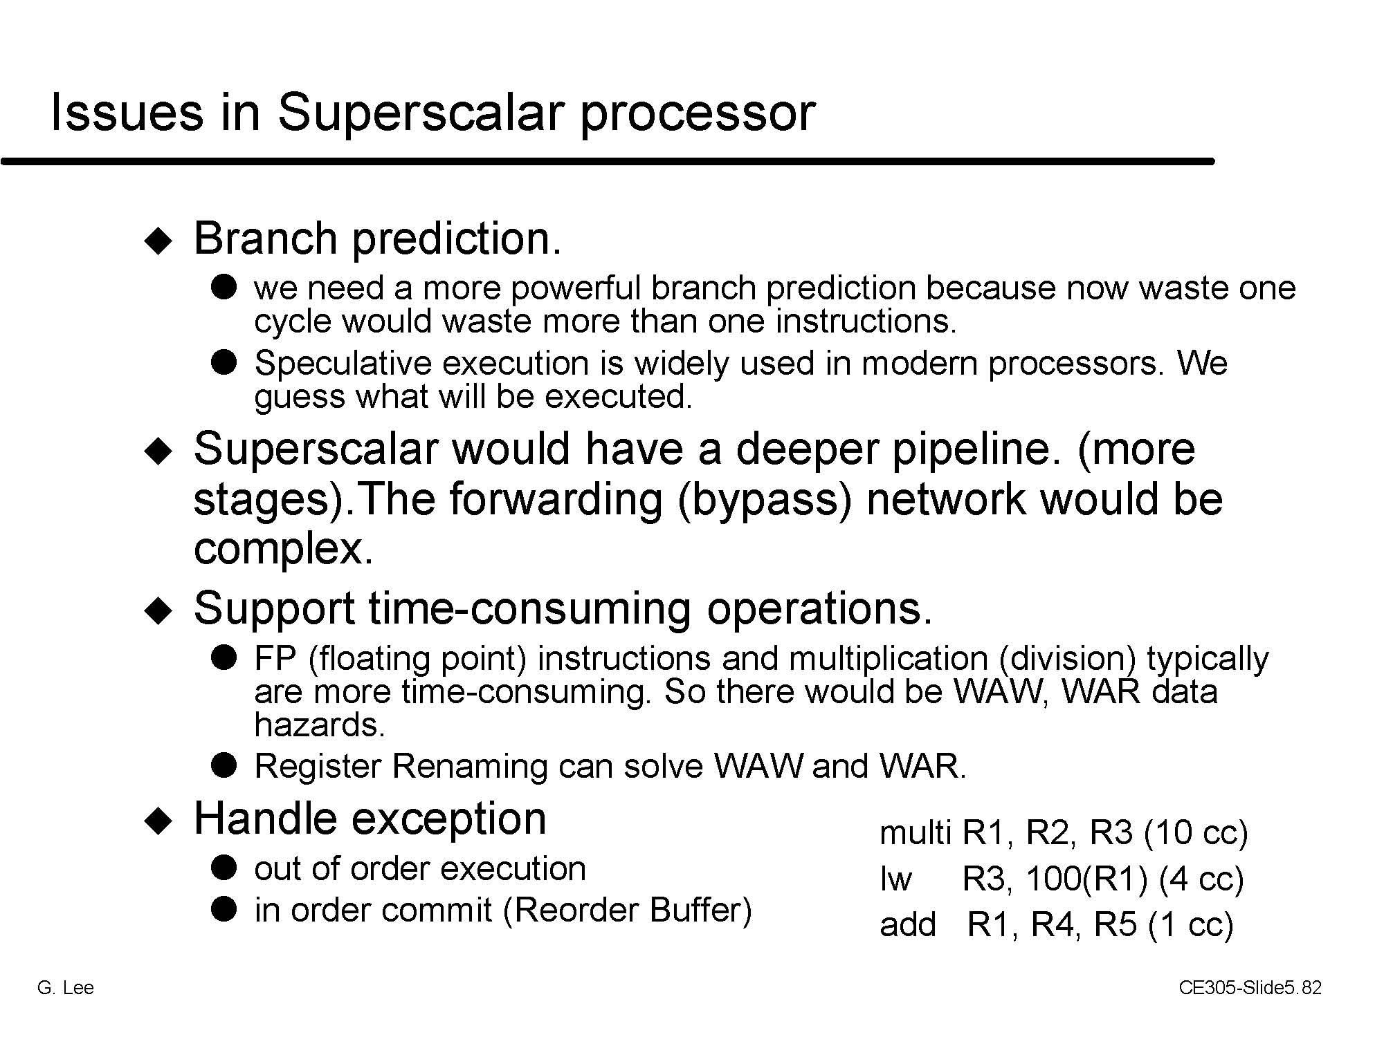
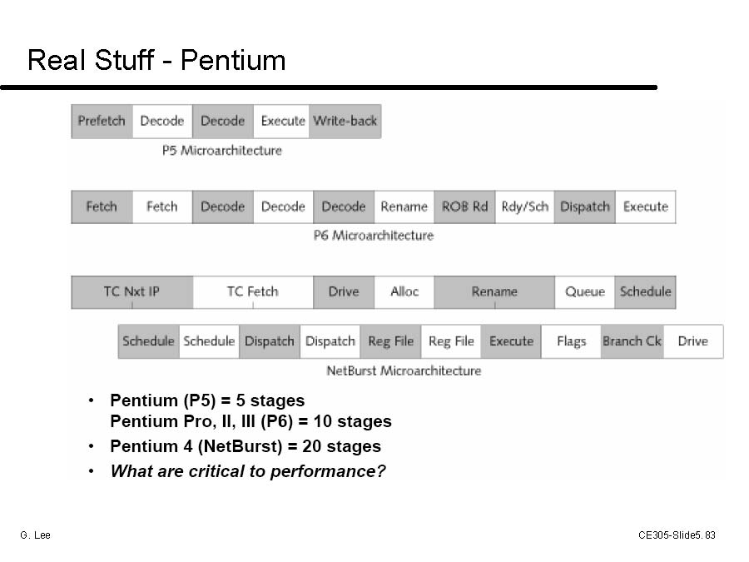
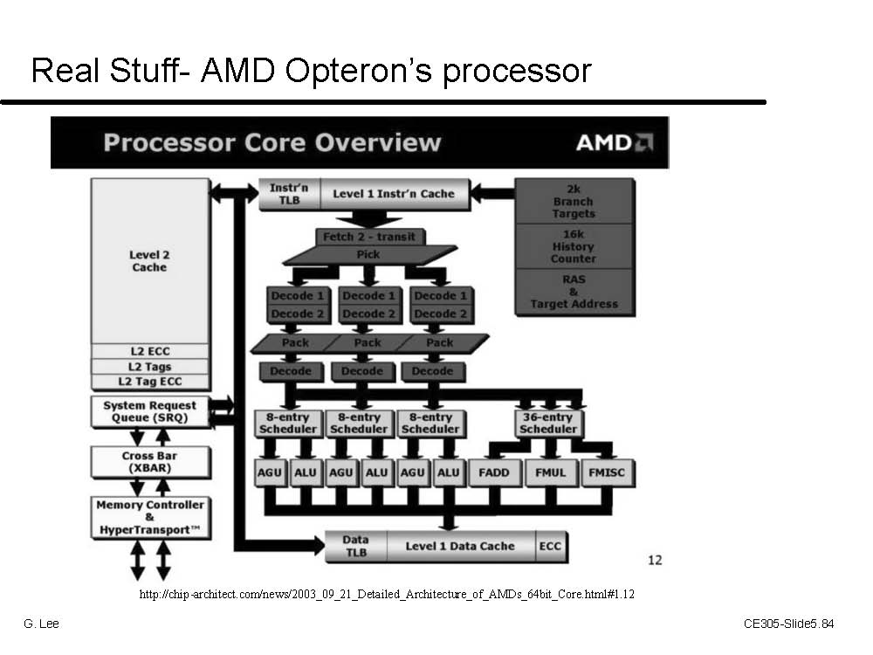
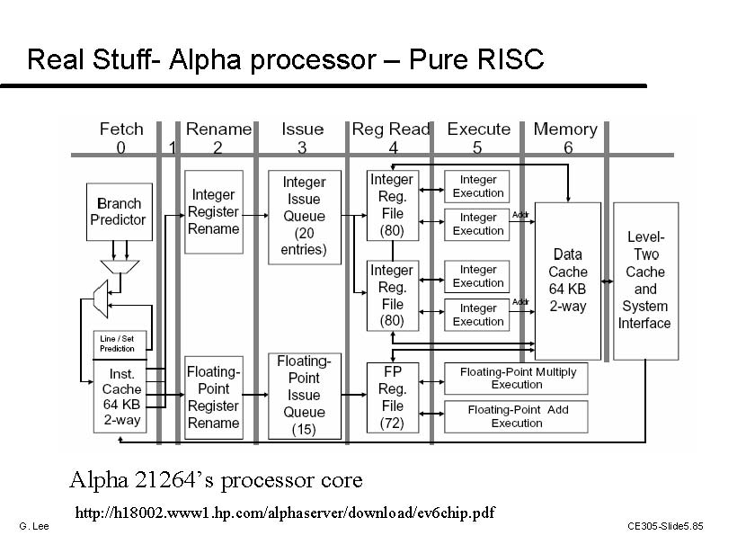
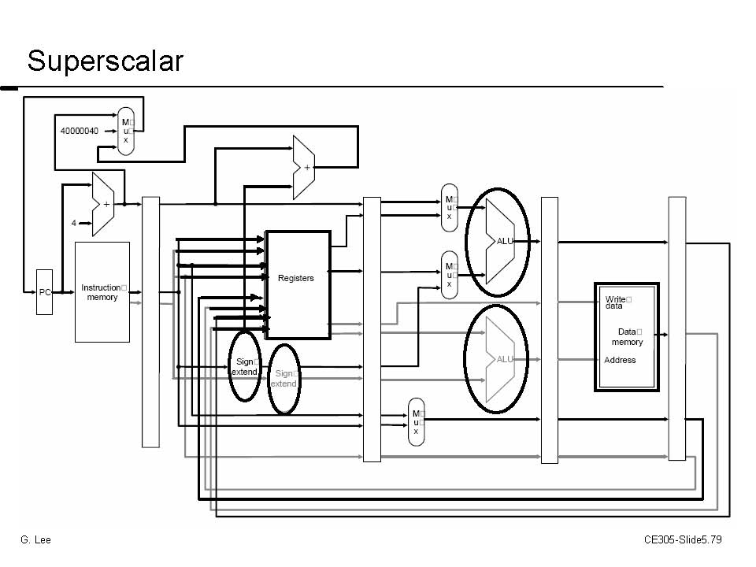
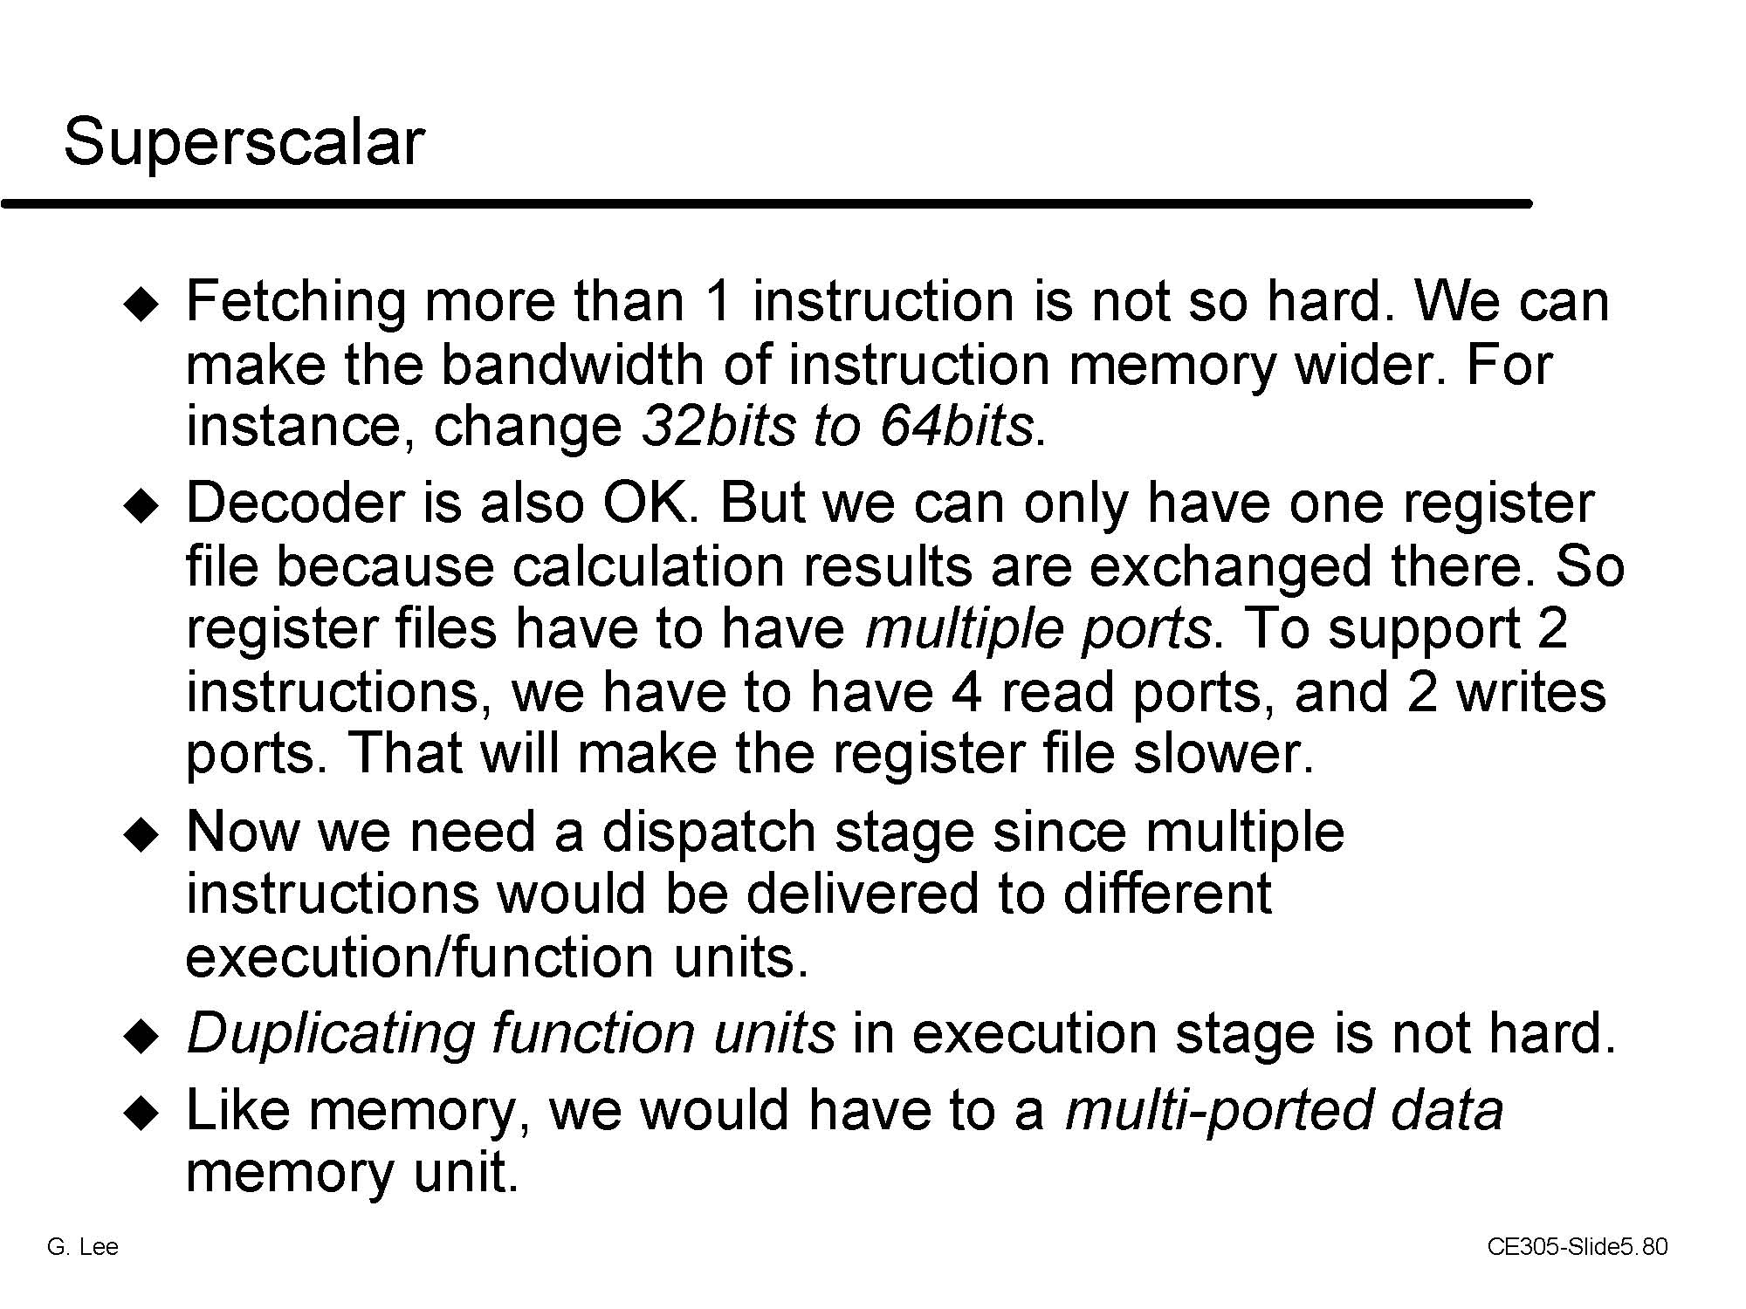
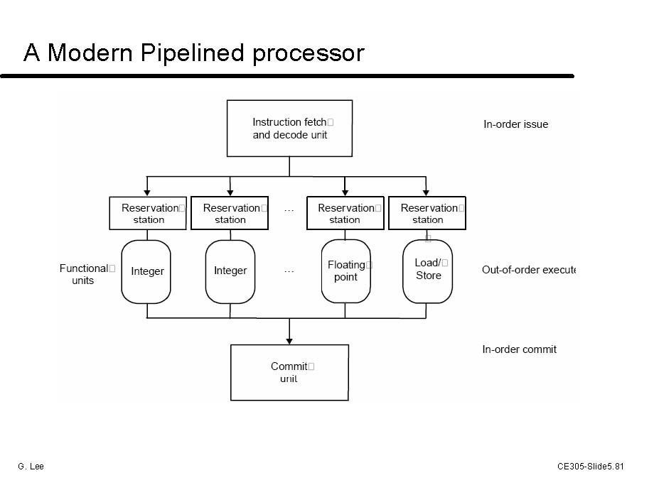

Slide 23
Dynamic Scheduling
The hardware performs the “scheduling”
  hardware tries to find instructions to execute
  out of order execution is possible
  speculative execution and dynamic branch prediction
All modern processors are very complicated
  DEC Alpha 21264: 9 stage pipeline, 6 instruction issue
  PowerPC and Pentium: branch history table
  Compiler technology important
finding more than one instructions (ILP)
This class has given you the background you need to learn more in graduate classes

Slide 25
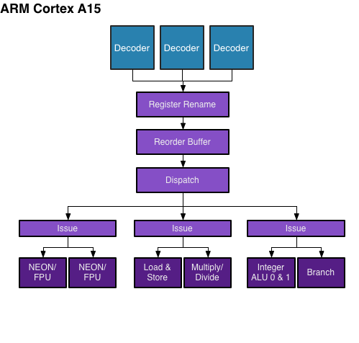
Real Stuff – ARM Cortex A15
Issue 3 instructions/cycle

Slide 26
More on Processor Architecture
CNCE433 – Computer Organization (?)
CNCE4xx – Processor Architecture
CRE652 – Advanced Processor Architecture

Slide 27
More on Processor Architecture
CNCE433 – Computer Organization (?)
CNCE4xx – Processor Architecture
CRE652 – Advanced Processor Architecture

Slide 28
More on Processor Architecture
CNCE433 – Computer Organization (?)
CNCE4xx – Processor Architecture
CRE652 – Advanced Processor Architecture

Slide 29
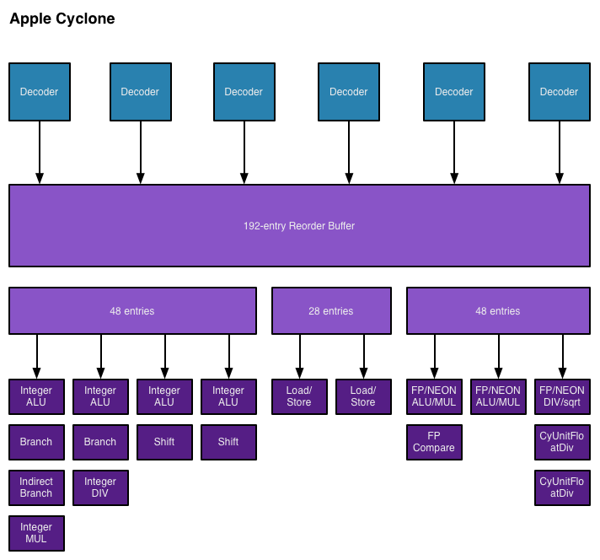
Recent AP – Apple A7
ARM ISA v8 64-bit

Slide 30
More on Processor Architecture
COSE422 – Processor Architecture in Fall semester

